Slide 1

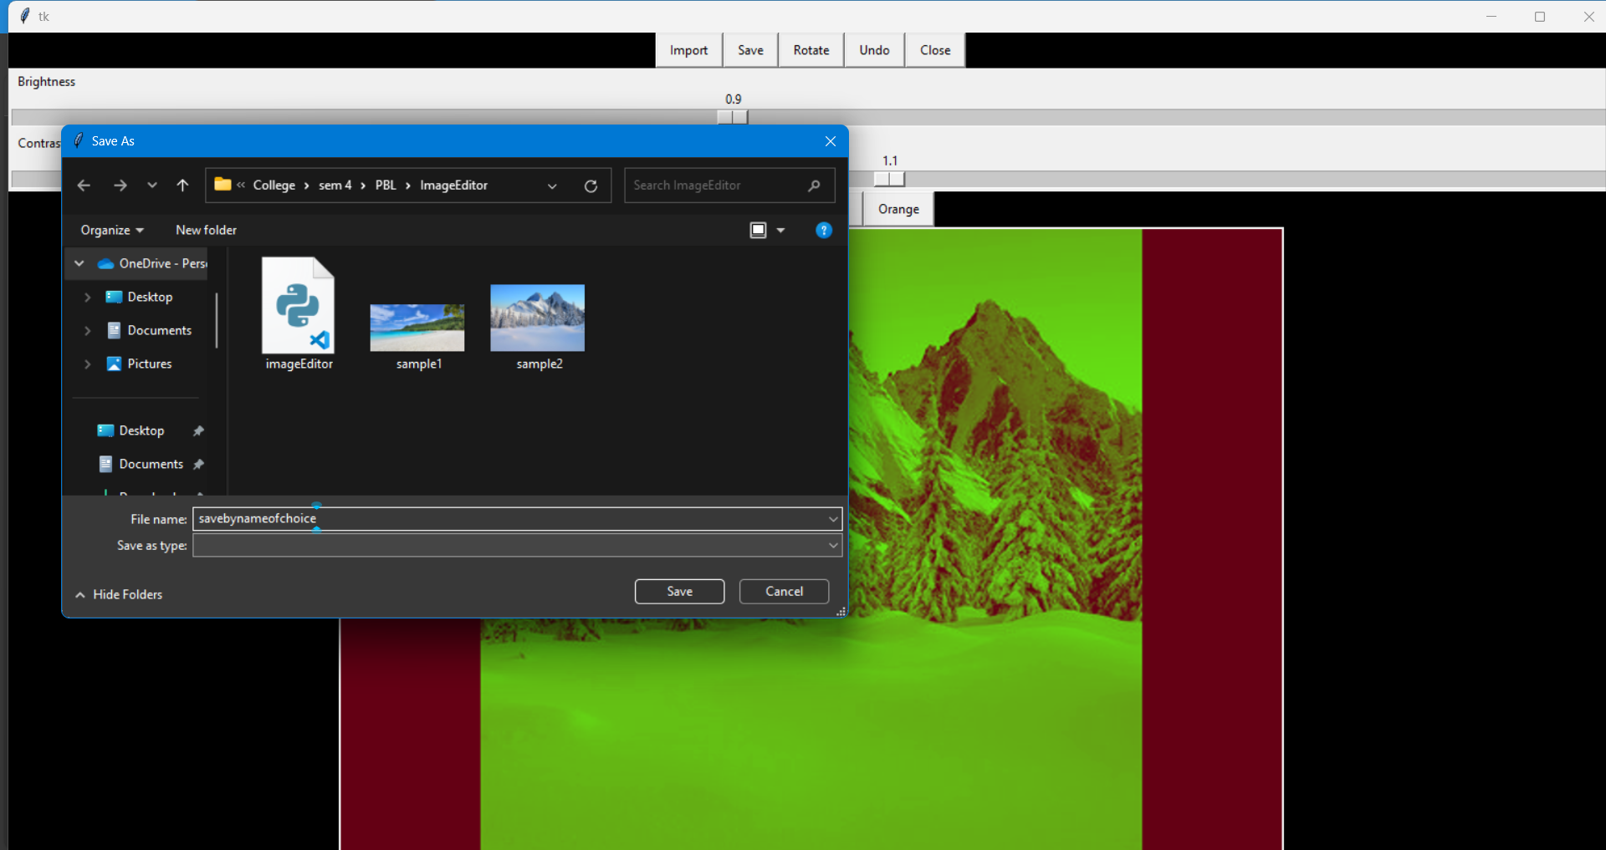
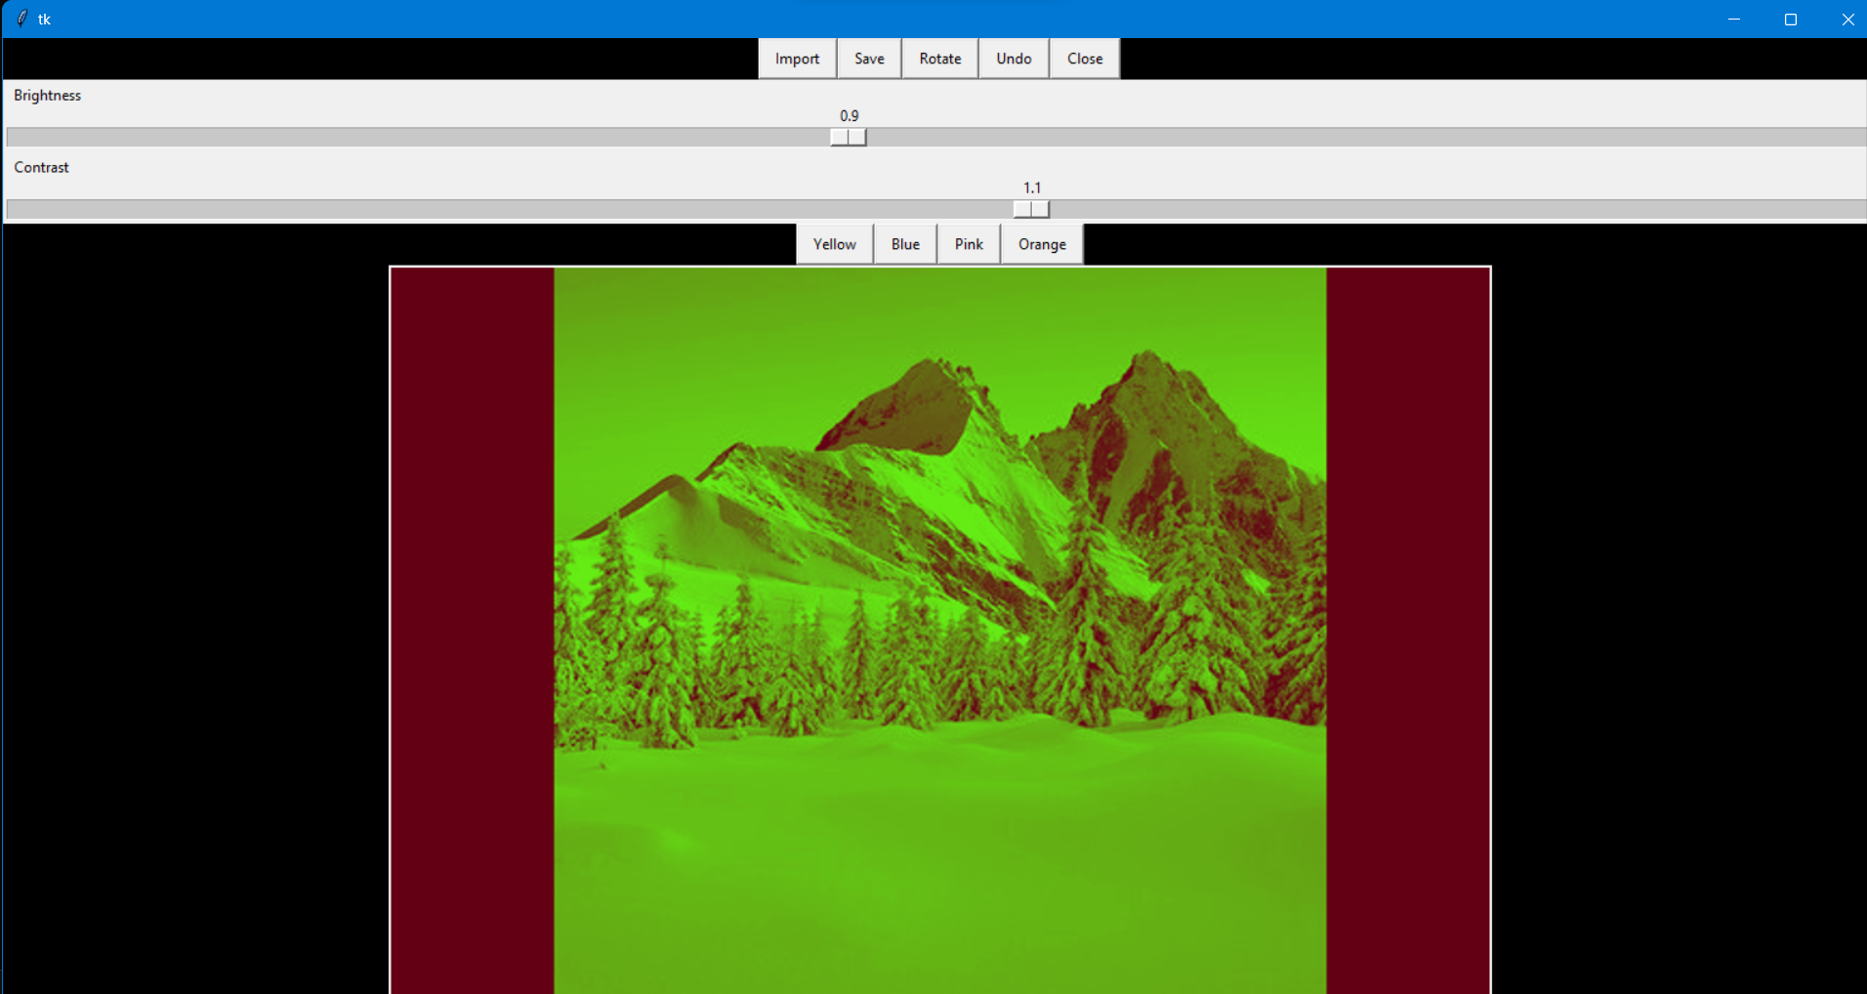
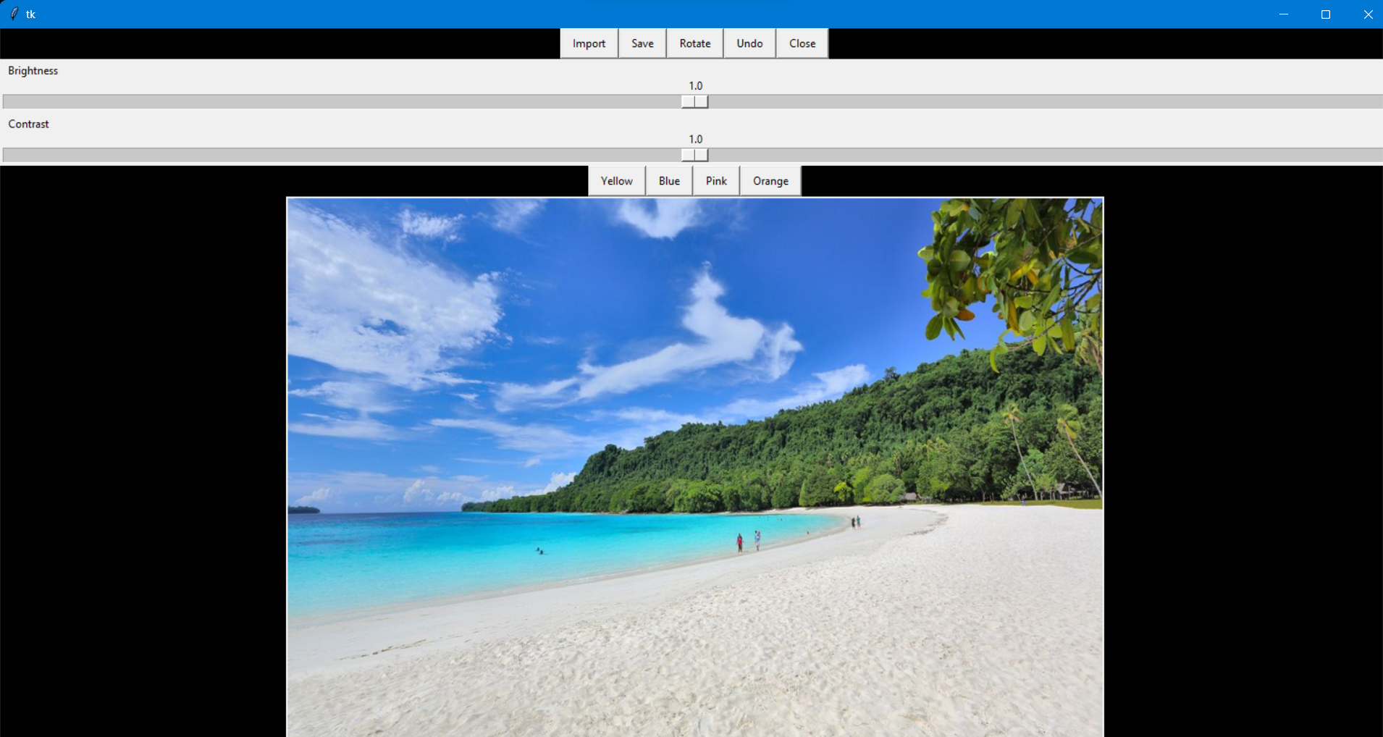
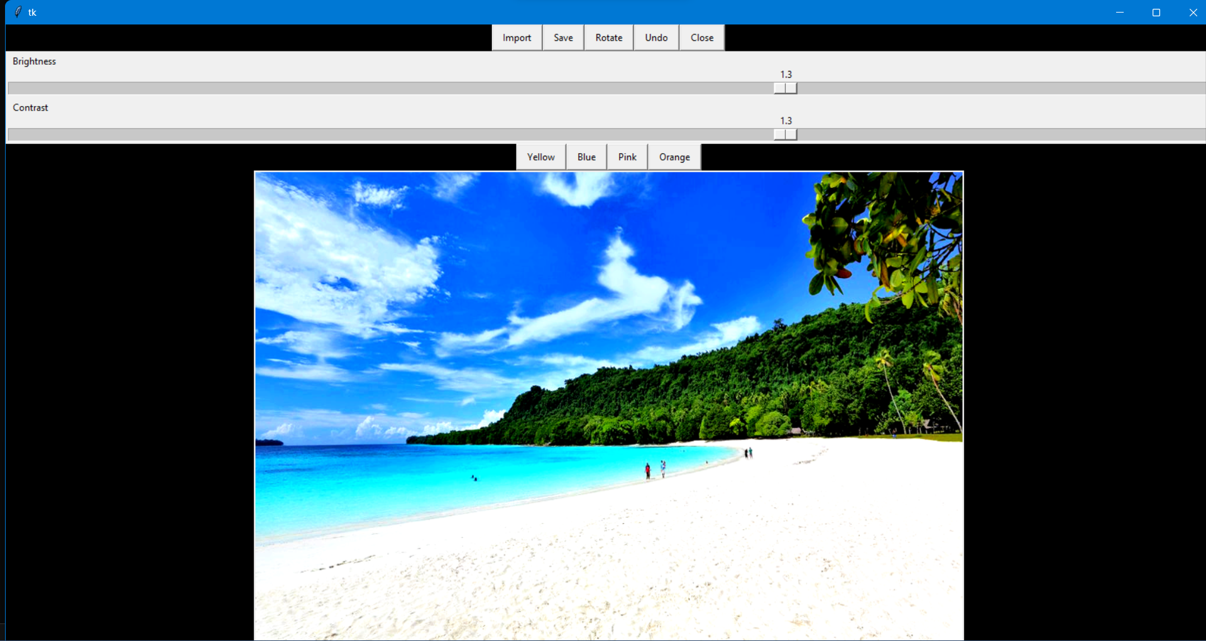
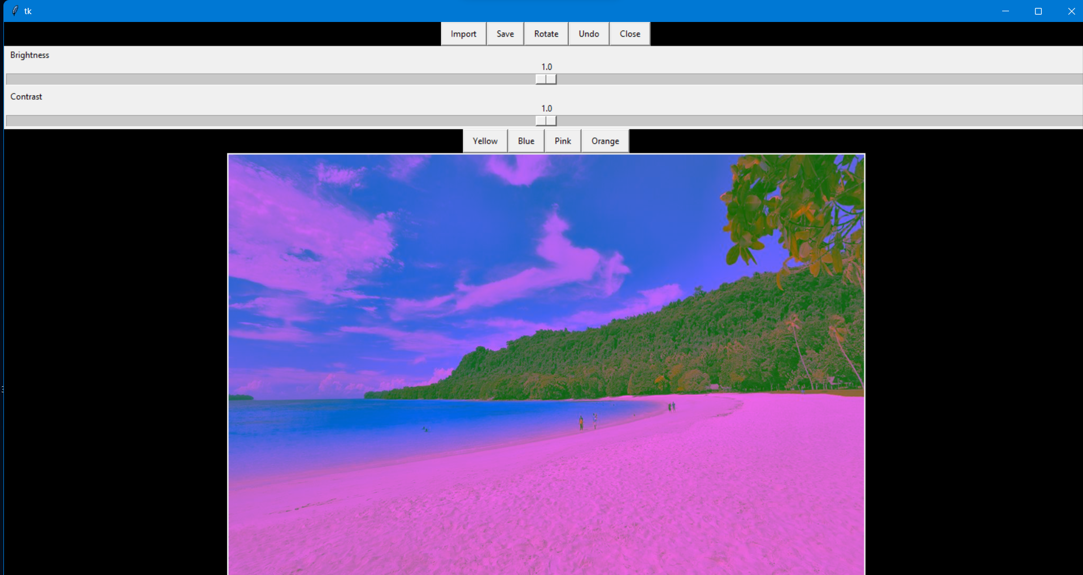
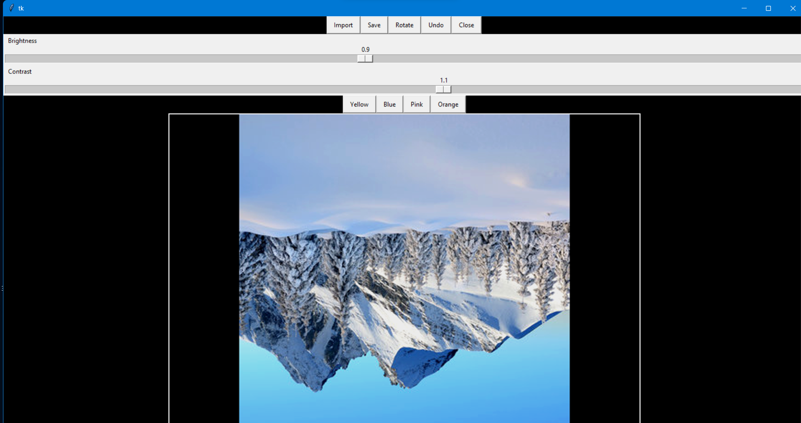
Image Editing Software
Amisha Banait
Manipal University Jaipur, Rajasthan, India
ABSTRACT
Dataset & Methodology
Methodology Cont..
Result
This Project is based on Python programming. Python is the most popular programming language. Python has vast libraries for various fields such as Machine Learning (Numpy, Pandas, Matplotlib), Artificial intelligence (Pytorch, TensorFlow), and Image editing modules (PIL). This project mainly uses tkinter, OpenCV and PIL modules.
The following modules are used for graphics user interface and image editing.
The idea of the project is to do basic image editing functions like adjusting the brightness and contrast, adding filters etc. It involves in importing the image first and editing the picture according to the user.
The project is currently in Phase 0, where it is in its base state and under development. It can do the basic functions of an image editor and I am planning to develop this project further where it is a fully functional image editor with a wide variety of tools and functions. The maximum time period to complete this project is assumed to be 2.5 to 3 months.
•def dispayImage(displayImage): This function is used for displaying the image into the main image editor window that is created by tkinter.
•def importButton_callback(): This functions is called when the ‘Import’ button created by the tkinter module is clicked. It imports the image, that is to be edited, from the destination folder to the softwares memory.
•def saveButton_callback(): This function is called when the ‘Save’ button created by the tkinter module is clicked. It saves the image with whatever changes that has been brought to the actual image.
•def closeButton_callback(): This function is called when the ‘Close’ button created by the tkinter module is clicked. It closes the complete image editor by terminating or destroying the window.
•def brightness_callback(brightness_pos): This function is called when the ‘Brightness’ slider created by the tkinter module is moved. It increases or decreases the brightness of the imported image.
def undoButton_callback(): This function is called when the ‘Undo’ button created by tkinter module is clicked. It performs the undo function on the image the number of times it is clicked (upto 5 times).
•def contrast_callback(contrast_pos): This function is called when the ‘Contrast’ slider created by the tkinter module is moved. It increases or decreases the contrast of the imported image.
•def yellowButton_callback(), def blueButton_callback(), def pinkButton_callback(), def orangeButton_callback(): These functions are called when the respective filter buttons created by tkinter module are clicked or selected. It adds colour filters to the imported image.
•def rotateButton_callback(): This function is called when the ‘Rotate’ button created by the tkinter module is clicked. It rotates the imported image by 90 degrees.
•def noneButton_callback(): This function is assigned just to check if the created button is working or not. It doesn’t carry out a relevant task.
On running the code, a tkinter window opens with widgets such as import, save, close etc. Other editing functions like rotate, adjust brightness and contrast, add color filters such as yellow, pink, blue and orange, and undo are all available in the main window itself in form of widgets.
We can start editing by first importing an image from the device. Now we can perform the basic editing functions like saving, rotating, closing, adjusting brightness and contrast, and adding color filters. On clicking the ‘Save’ button the save dialog box appears. The image can be saved with a name of user’s choice.
INTRODUCTION
Image editing is so common these days that software related to image editing are available on many electronic devices like cell phones and computers. The idea of my project is to use python programming and its related modules to create a simple, user-friendly image editing software. The modules used in this program are Tkinter, OpenCV and PIL.
Tkinter is a Python framework included in standard Python distributions, serving as the primary method for building Graphical User Interfaces (GUIs). It interfaces with the Tk toolkit, providing a user-friendly way to create GUI elements such as buttons and menus. These widgets can be programmed to interact with user actions or other elements within the application.
OpenCV, an open-source computer vision library, offers over 2500 optimized algorithms for tasks like face recognition, object detection, and image processing. It's BSD-licensed, making it accessible for commercial use and modification. OpenCV's extensive capabilities attract a large user base across various industries and research fields. Python's simplicity and available modules make it ideal for creating applications like image editors, leveraging basic programming skills like function creation and list manipulation.
Conclusion
Using the basic knowledge of python programming languages and its modules, I have created an image editor successfully. The image editor is capable of performing the following functions: -
Importing Images
Saving Images
Rotating Images
Adjusting Brightness
Adjusting Contrast
Adding Color Filters
Undoing
Closing the editor
In the end, the created project is basic but has the possibility of future development. With a little more detailed study of python and its associated libraries, it can further be developed by adding other features that an advanced image editor has along with creating new features and tools that can make it unique.
Reference
STACK OVERFLOW: https://stackoverflow.com is a question & answer website for professional and enthusiast programmers. It is the flagship site of the Stack Exchange Network. It was created in 2008 by Jeff Atwood and Joel Spolsky.
GEEKS FOR GEEKS: GeeksforGeeks is an portal for computer geeks where you will find a bunch of articles, quizzes on programming and algorithm. Geeksforgeeks is a platform for learning tech related topics, engineering syllabus, they have online as well as offline courses for on-demand topics like C++, Java programming, campus placement etc.
UDEMY: (2022 Complete Python Bootcamp from Zero to Hero in Python) Jose Portilla on Udemy is seriously a great course to learn Python. It's clear, comprehensive, engaging, hands-on, and at the same time very cost-effective and affordable.
FREE CODE CAMP: freeCodeCamp is a non-profit organization that consists of an interactive learning web platform, an online community forum, chat rooms, online publications and local organizations that intend to make learning web development accessible to anyone.
GITHUB: GitHub, Inc. is a provider of Internet hosting for software development and version control using Git.
YOUTUBE: YouTube Helping millions of students and self-taught programmers learn fundamental and advanced programming concepts through free and paid online courses.

